Slide 1

Paper Id: 1159 A Dimensionality Reduction based Efficient Multiple Voice Disease Recognition Scheme using Mel-Frequency Cepstral Coefficients and K-Nearest Neighbors Algorithm Shovan Bhowmik, Mahedi Hasan, and Muhammad Ataul Hakim Presenting Author: Shovan Bhowmik
International Conference on Big Data, IoT and Machine Learning (BIM 2021) Date: September 23-25, 2021

Slide 2
Outline
Introduction
Problem Statement
Literature Review
Research Questions
Objectives
Outcomes and Impacts
Methodology
Experimental Results
Conclusion
Future Research Direction
References

Slide 3
Introduction
Disease diagnosis in medical healthcare leveraging machine learning (ML) is an area of significant interest in the whole world.
Researchers have shifted their experiments towards non-invasive disease identification in medical science which can help people to identify malady in a fast, low-cost and trustworthy way.
Voice pathology detection has been a promising area where extracting different acoustic features, for example, Shimmer (%), Jitter (%), Fundamental Frequency (F0), Mel-Frequency Cepstral Coefficients (MFCC), Wavelet Packet Decomposition (WPD), etc. along with ML and Deep Learning (DL) algorithms can produce disorder recognition framework.

Slide 4
Problem Statement
Vocal cord malady can immerse anytime from tissue contagion, vocal fold contraction, vocal surface vexation, various bad habits (loud sound, smoking, extra force on vocal cords, etc.), neurological imbalance, etc.
According to the “Hopkins Medicine Organization”, people suffer more from Laryngitis, Dysphonia and Renkei’s Edema that occur because of vocal cord trouble.
Occurrences of the diseases:
Dysphonia – Nodule creation, Swelling in Larynx, Traumatic shock in Vocal fold Laryngitis – Swelling in Vocal Fold, Virus Attacks
Renkei’s Edema – Overstress, Immoral habits
Clinical recognition of the voice disorders are time consuming and expensive.

Slide 5
Literature Review
So far many research contributions are available regarding voice disorder identification. (Binary)
Author | Work | Result | Limitation
Harar et al.[2020] | - Voice pathology identified from Acoustic features and MFCC by applying XGBoost, Isolation Forest, DenseNet | Applied on four databases 0.733 F1-Score, 0.759 Precision | Dimensionality Reduction was not utilized Only vowels are considered
Dankovičová et al. [2018] | - Detected Dysphonia by exerting SVM, K-NN and Random Forest with Shimmer, Jitter, MFCC Features | - The highest 91.3% accuracy was achieved with PCA | - Accuracy ranges from 65% to 80%
Mythili et al. [2018] | - Performance based Comparative analysis between ensemble models on Pitch, Intensity, MFCC, WPD were illustrated | - 96% accuracy was gained | cross-validation was not considered Specific voice diseases were not classified

Slide 6
Literature Review (Cont..)
So far many research contributions are available regarding voice disorder identification. (Binary)
Author | Work | Result | Limitation
Mohammed et al. [2020] | - Voice pathology recognition was performed with a CNN Network | 95.41% accuracy was obtained on SVD Database | Dimensionality Reduction was not considered No comparison was placed with ML models
Our Proposed Model | Multiple voice diseases have been recognized with MFCC features and dimensionality reduction techniques Sentences have been considered as input audio Execution time and Cross-Validation analysis Proper comparison and better performance | Performance: Almost 97% accuracy has been reached with K-NN and LDA based recognition Need 23 milliseconds only to train the reduced audio features with machine learning algorithms A full portray of performance variation among PCA, LDA and without dimensionality reduction in sequential data | - Accuracy ranges from 65% to 80%

Slide 7
Research Questions
Can we create a robust multiple voice disease recognition framework for non-invasive and early identification of voice disorders?
Is this possible to create a benchmark model with reduced dimensionality to find quick results without overfitting?
Do dimensionality reduction techniques act differently in sequential data analysis?

Slide 8
Objectives
To create an efficient multi-class voice disease recognition framework.
To observe the performance of Dimensionality Reduction Techniques.
To present a comparison among several ML and DL algorithms.
To create a pathway towards more research associated with signal processing.

Slide 9
Outcomes and Impacts
OUTCOMES:
A multi-labeled voice disease recognition model was devised from 13-MFCC feature matrix extraction by applying machine learning algorithms and Linear Discriminant analysis.
IMPACTS:
People can forecast voice diseases by simply recording the audio samples.
Easily deployable in end-to-end devices.
More research scopes can be invented based on multi-modal and multi-linguistic studies.

Slide 10
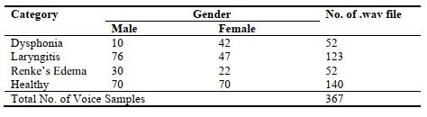
Methodology
Dataset Description:
367 voice samples from a well-known and commonly used audio database namely the “Saarbruecken Voice Database” were considered.
All voices were sampled at 50 KHz.
Each of the audio clips picked for this work utters “Guten Morgen, wie geht es Ihnen?”

Slide 11
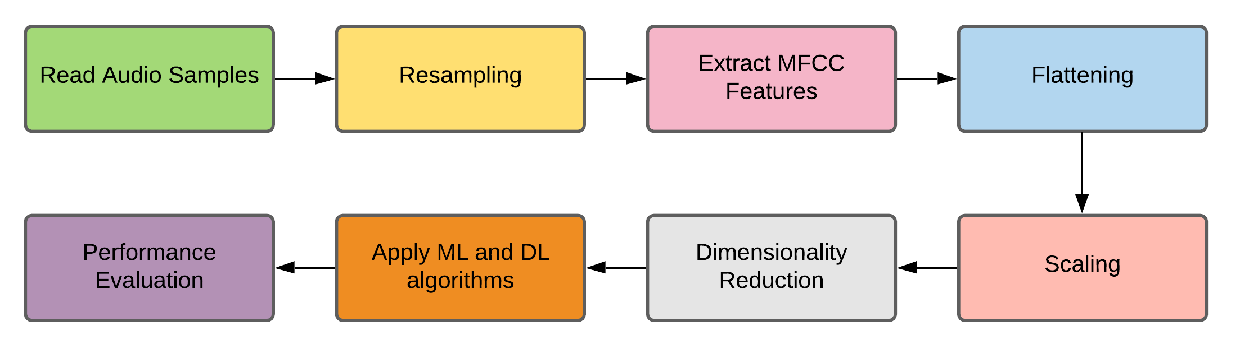
Methodology (Cont..)
Overall Workflow:

Slide 12
Methodology (Cont..)
Conversion of all signals to a ‘mono’ channel.
Resampled into 22 KHz.

Slide 13

Methodology (Cont..)
Computed to determine the spectral information of the voice.
13 MFCC features for each voice signal was calculated using the following equation:

Slide 14
Methodology (Cont..)
Since the largest audio length in our dataset consisted of 213 frames, (213 × 13) matrix has been converted into a (1 × 2769) feature vector.
Zero padding was applied to the varying lengths.
Finally, a (367 × 2769) MFCC feature matrix was produced.

Slide 15
Methodology (Cont..)
Standard Scaler was applied to normalize the MFCC values into a smaller range for making a cost-effective model.

Slide 16

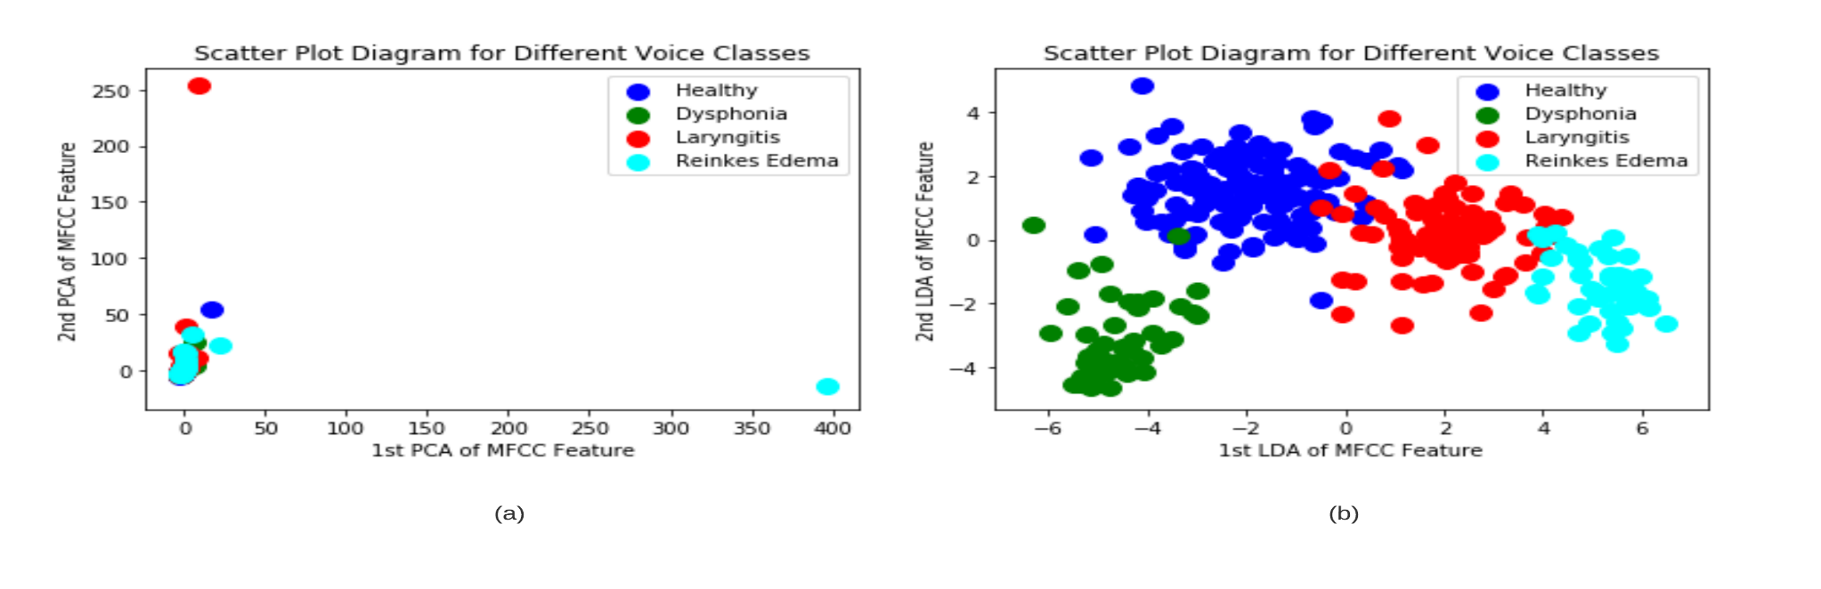
Methodology (Cont..)
Dimensionality Reduction:
Unsupervised PCA works on the correlation between the features by placing the data points in the subspace which has the maximum variance.
LDA always tries to sum up the 1-D mean vectors by between class and within class matrix calculation in a supervised manner.
LDA converted (367 × 2769) matrix into (367 × 3) matrix.
PCA converted (367 × 2769) matrix into (367 × 367) matrix.

Slide 17
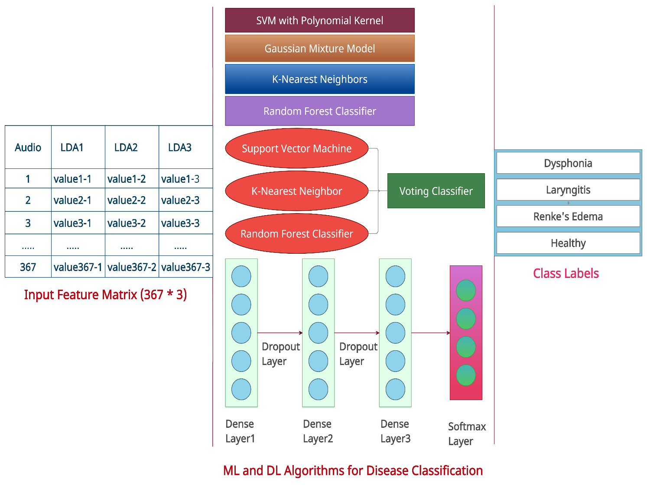
Methodology (Cont..)
Applying ML and DL Algorithms:
One supervised (SVM), one unsupervised (K-NN), one probabilistic (GMM), one ensemble (RF) and one neural network (ANN) algorithms have been chosen.
SVM – Polynomial kernel with degree 3
GMM – Covariance type: Spherical with 300 Max. Iterations
KNN and RF – Default parameters
ANN – 256 neurons each layer, Adam optimizer, Relu activation function, 0.0001 learning rate.

Slide 18

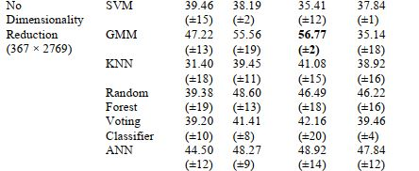
Experimental Results
Performance Analysis of Several ML and DL Algorithms for Four Cross Validation Techniques:

Slide 19
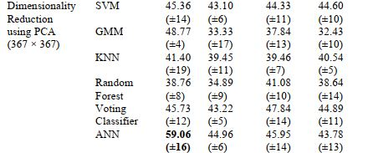
Experimental Results (Cont..)
Performance Analysis of Several ML and DL Algorithms for Four Cross Validation Techniques:

Slide 20
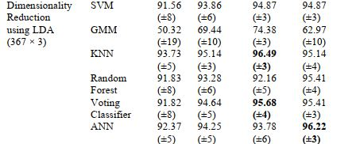
Experimental Results (Cont..)
Performance Analysis of Several ML and DL Algorithms for Four Cross Validation Techniques:

Slide 21
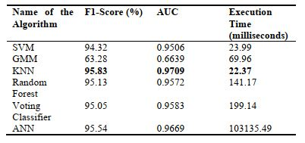
Experimental Results (Cont..)
As LDA depended clustering framework has outperformed the other two criteria by a massive margin, we have observed the F1 Score, AUC area and execution time for the best cross-validation results for each model.

Slide 22
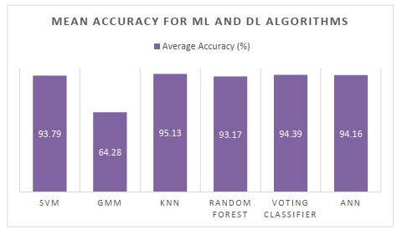
Experimental Results (Cont..)
Mean Accuracy of the Cross-Validation Approaches for LDA based Disease Recognition:

Slide 23
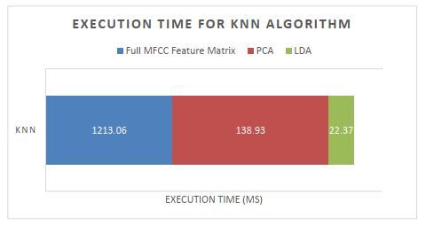
Experimental Results (Cont..)
Execution time comparison among three criteria for KNN Algorithm:

Slide 24
Conclusion
Voice diseases can cause brain stroke or cancer which can lead to death if proper precaution is not taken.
We have proposed LDA based multi-label voice disease recognition model with ML and DL algorithms and shown a remarkable rise in accuracy while using LDA as a dimensionality reduction system instead of PCA or without dimension exclusion strategy.
Our empirical study has successfully predicted four voice class labels using this scheme with the foremost 96.49% accuracy and surpassed five other mining algorithms including Artificial Neural Network.

Slide 25
Future Research Direction
Multi-Modal and Multi-Linguistic studies can be introduced.
More ML and DL algorithms can be incorporated.
Which types of audio signals are more accurate can be studied.
Other than MFCC, more voice features can be considered.
Private databases with more audio signals can be studied.

Slide 26
References
1. Mythili, J., Vijaya, M. S.: Pathology Voice Detection and Classification Using Ensemble Learning. International Journal of Engineering Science Invention (IJESI), 7(8), 1-8 (2018). 2. Titze, I. R., Martin, D. W.: Principles of voice production. Prentice-Hall, Englewood Cliffs (1998). 3. Voice Disorders. https://www.hopkinsmedicine.org/health/conditions-and-diseases/voicedisorders, last accessed 2021/05/14. 4. Internal Medicine. https://www.medstarsouthernmaryland.org/our-services/internalmedicine/conditions/ear-nose-and-throat-conditions/voice-and-swallowing-disorders/, last accessed 2021/05/14. 5. Martins, R. H. G., do Amaral, H. A., Tavares, E. L. M., Martins, M. G., Gonçalves, T. M., Dias, N. H.: Voice disorders: etiology and diagnosis. Journal of voice, 30(6), 761-e1 (2016). 6. Uma Rani, K., Holi, M. S.: A hybrid model for neurological disordered voice classification using time and frequency domain features. Artificial Intelligent Research, 5(1), 87-94 (2016). 7. Verde, L., De Pietro, G., Sannino, G.: Voice disorder identification by using machine learning techniques. IEEE access, 6, 16246-16255 (2018). 8. Alhussein, M., Muhammad, G.: Voice pathology detection using deep learning on mobile healthcare framework. IEEE Access, 6, 41034-41041 (2018). 9. Verde, L., De Pietro, G., Alrashoud, M., Ghoneim, A., Al-Mutib, K. N., Sannino, G.: Leveraging Artificial Intelligence to Improve Voice Disorder Identification Through the Use of a Reliable Mobile App. IEEE Access, 7, 124048-124054 (2019). 10. Harar, P., Galaz, Z., Alonso-Hernandez, J. B., Mekyska, J., Burget, R., Smekal, Z.: Towards robust voice pathology detection. Neural Computing and Applications, 32, 15747–15757 (2020). 11. Dankovičová, Z., Sovák, D., Drotár, P., Vokorokos, L.: Machine learning approach to dysphonia detection. Applied Sciences, 8(10), 1927 (2018). 12. Boyanov, B., Hadjitodorov, S.: Acoustic analysis of pathological voices. A voice analysis system for the screening of laryngeal diseases. IEEE Engineering in Medicine and Biology Magazine, 16(4), 74-82 (1997). 13. Harar, P., Alonso-Hernandezy, J. B., Mekyska, J., Galaz, Z., Burget, R., & Smekal, Z. Voice pathology detection using deep learning: a preliminary study. In: 2017 international conference and workshop on bioinspired intelligence (IWOBI), pp. 1-4. IEEE, Funchal, Portugal (2017). 14. Mohammed, M. A., Abdulkareem, K. H., Mostafa, S. A., Ghani, M. K. A., Maashi, M. S., Garcia-Zapirain, B., Alhakami, H., Al-Dhief, F. T.: Voice pathology detection and classification using convolutional neural network model. Applied Sciences, 10(11), 3723 (2020).

Slide 27
References (Cont..)
15. Choubey, D. K., Kumar, M., Shukla, V., Tripathi, S., Dhandhania, V. K.: Comparative analysis of classification methods with PCA and LDA for diabetes. Current diabetes reviews, 16(8), 833-850 (2020). 16. Pützer, M., Koreman, J.: A German database of patterns of pathological vocal fold vibration. Phonus, 3, 143-153 (1997). 17. McFee, B., Raffel, C., Liang, D., Ellis, D. P., McVicar, M., Battenberg, E., Nieto, O.: librosa: Audio and music signal analysis in python. In: Proceedings of the 14th python in science conference, 8, 18-25 (2015). 18. Gupta, S., Jaafar, J., Ahmad, W. W., Bansal, A.: Feature extraction using MFCC. Signal & Image Processing: An International Journal (SIPIJ), 4(4), 101-108 (2013). 19. Poorjam, Hossein, A.: Why we take only 12-13 MFCC coefficients in feature extraction? https://rb.gy/2mimzc, last accessed: 2018/05/31. 20. Arjmandi, M. K., Pooyan, M., Mohammadnejad, H., Vali, M.: Voice disorders identification based on different feature reduction methodologies and support vector machine. In: 2010 18th Iranian Conference on Electrical Engineering, pp. 45-49, IEEE, Isfahan, Iran (2010). 21. Bhowmik, S., Reno, S., Sultana, S., Ahmed, M.: Clusterization of Different Vulnerable Countries for Immigrants Due to Covid-19 Using Mean Probabilistic Likelihood Score and Unsupervised Mining Algorithms. In: 2021 International Conference on Information and Communication Technology for Sustainable Development (ICICT4SD), pp. 285-290, IEEE, Dhaka, Bangladesh (2021). 22. Ottensen, C.: Comparison between PCA and LDA. https://dataespresso.com/en/2020/12/25/comparison-between-pca-and-lda/, last accessed: 2020/12/25. 23. Sarkar, P.: What is LDA: Linear Discriminant Analysis for Machine Learning. https://www.knowledgehut.com/blog/data-science/linear-discriminant-analysis-formachine-learning, last accessed: 2019/09/30. 24. Mehta, A.: Everything You Need to Know About Linear Discriminant Analysis. https://www.digitalvidya.com/blog/linear-discriminant-analysis/, last accessed: 2020/01/04. 25. Priya, R., de Souza, B. F., Rossi, A. L., de Carvalho, A. C.: Predicting execution time of machine learning tasks for scheduling. International Journal of Hybrid Intelligent Systems, 10(1), 23-32 (2013).

Slide 28
Thank You

